Slide 1
AIMS Paper Figures

Slide 2
Results Outline
More ELA → lower resilience + higher trait anxiety
eBMRQ + ELA: four block figure (AIMS + threat/CHAOS for both studies)
HUMS ~ absorption
Escapism ~ BMRQ + AIMS subscales.
Absorption → resilience
Mediation model (CHAOS - AIMS - resilience)
N.s. for just childhood CHAOS
Significant for adolescence CHAOS
CHAOS mediation remained sig w/ age as a covariate (cite music reward decreasing of age/retrospective reporting could be confound)
- temporally-specific measures?
-consider goldMSI measures for specificity of AIMS effects (correlations w/ AIMS – explore w/ ELA/STAI/resilience)
-was age related to any outcomes of interest outside of mediation model? (correlations w/ AIMS, eBMRQ[abs], STAI, resilience, escapism, HUMS)

Slide 3
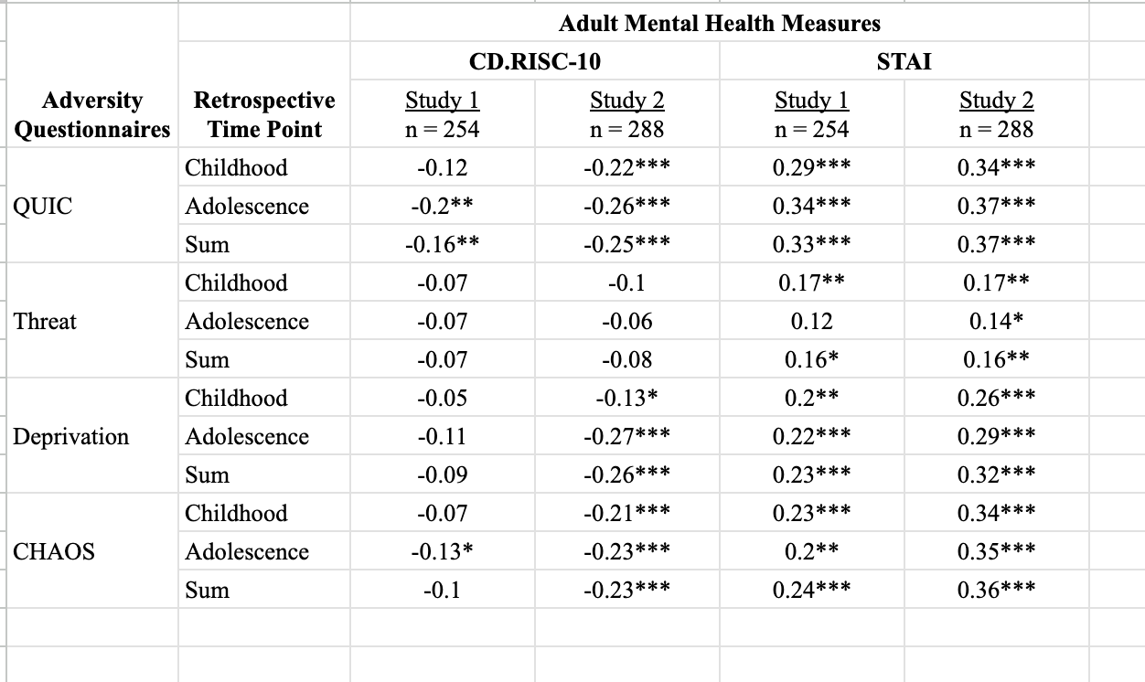
ELA & Mental Health Outcomes Table

Slide 4
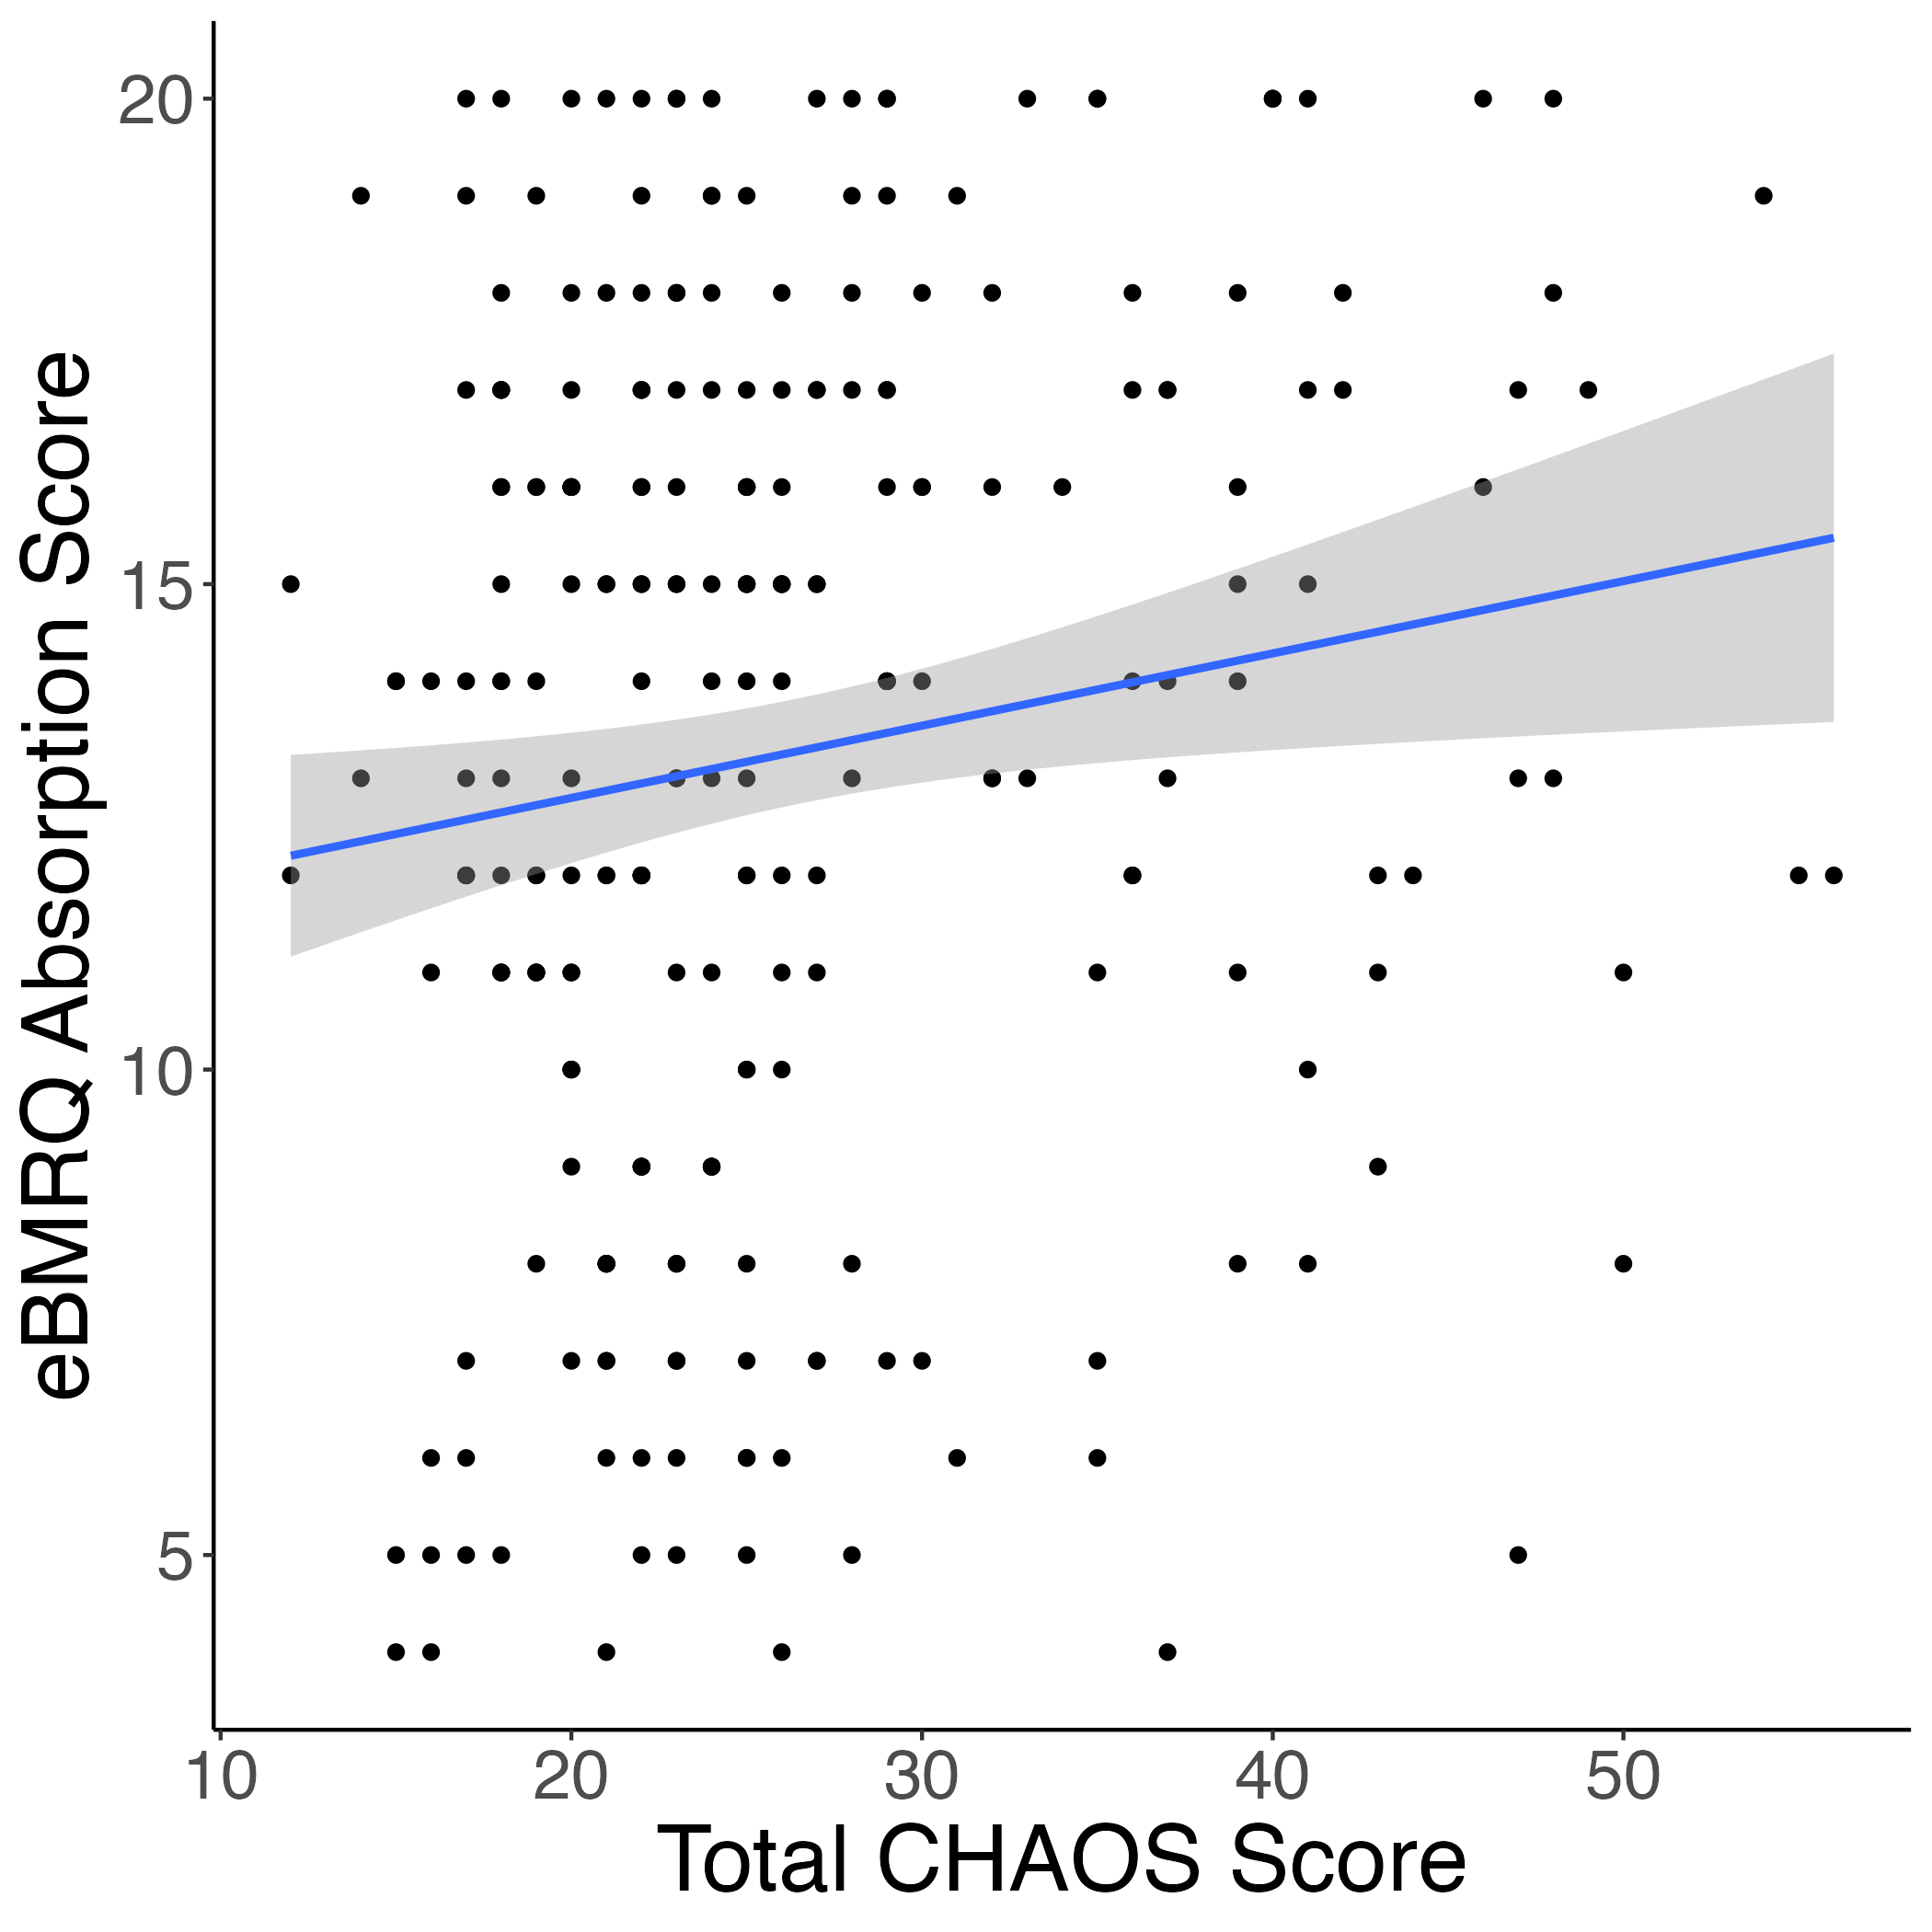
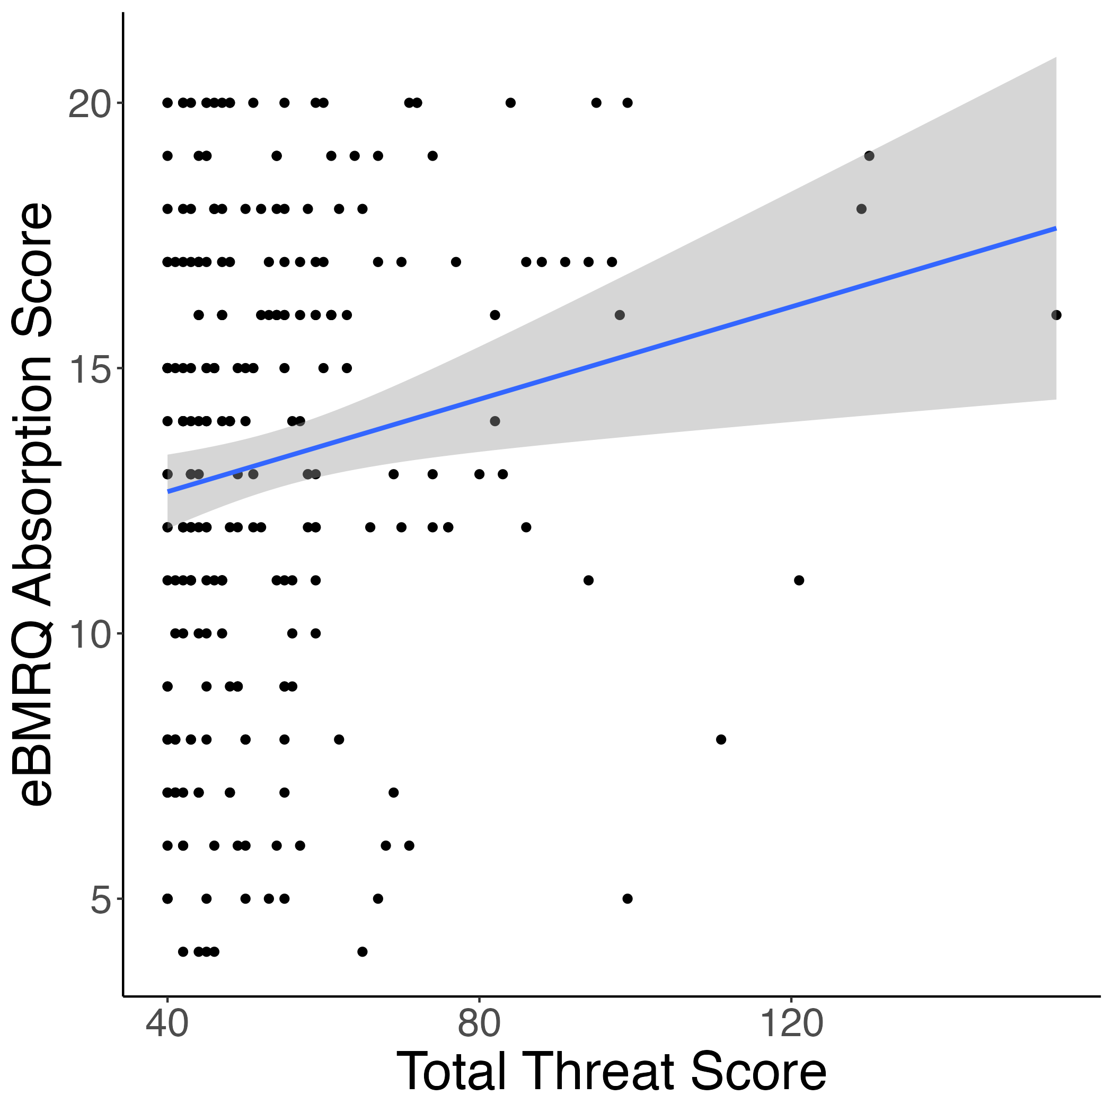
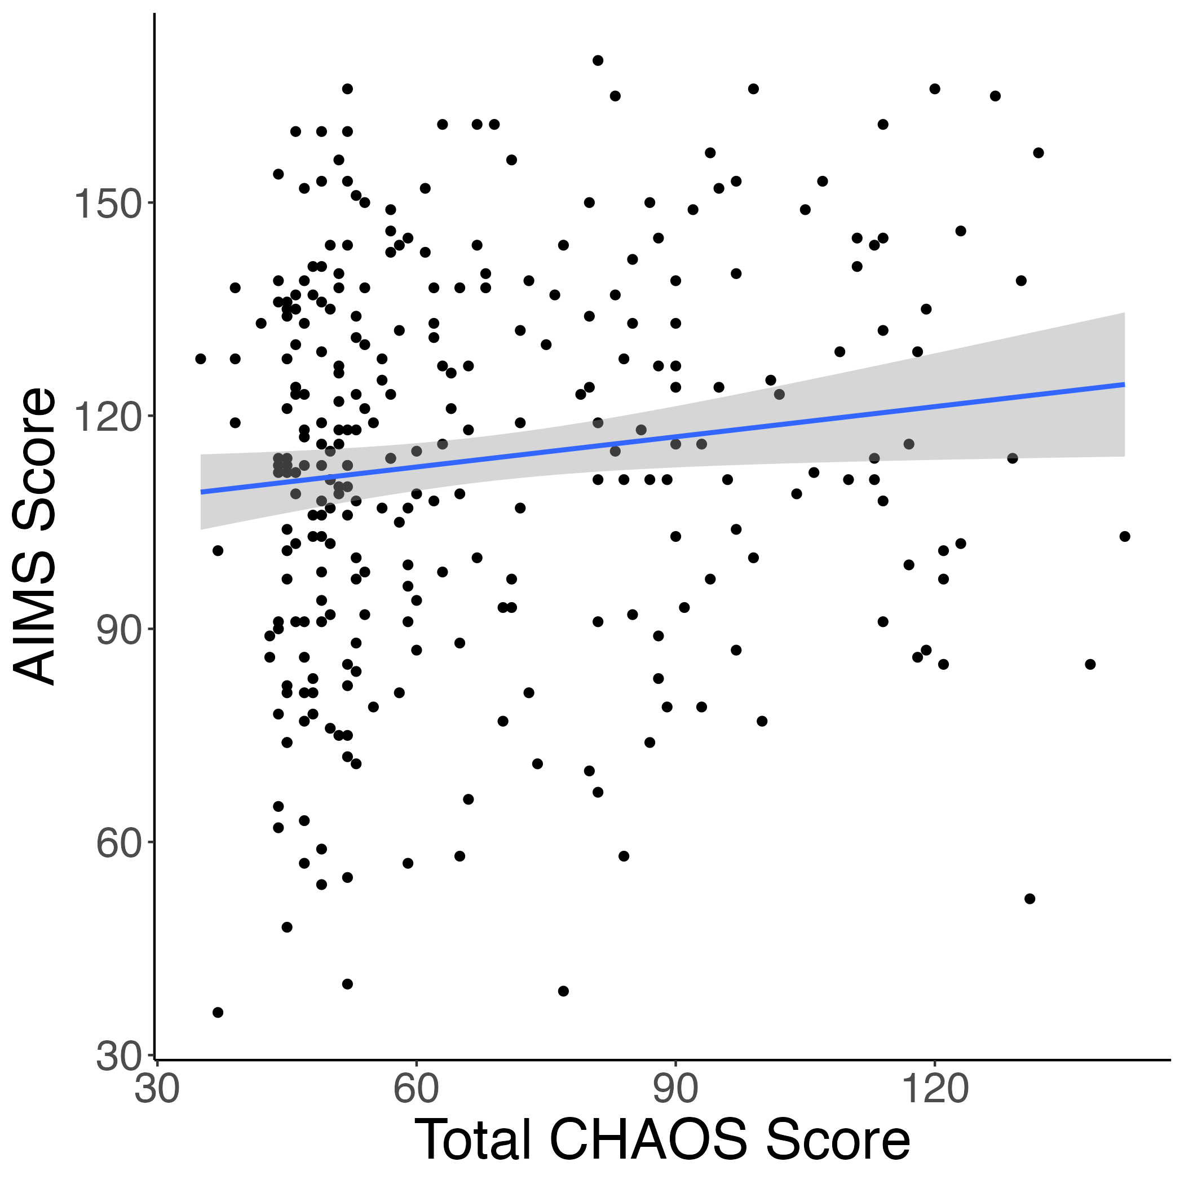
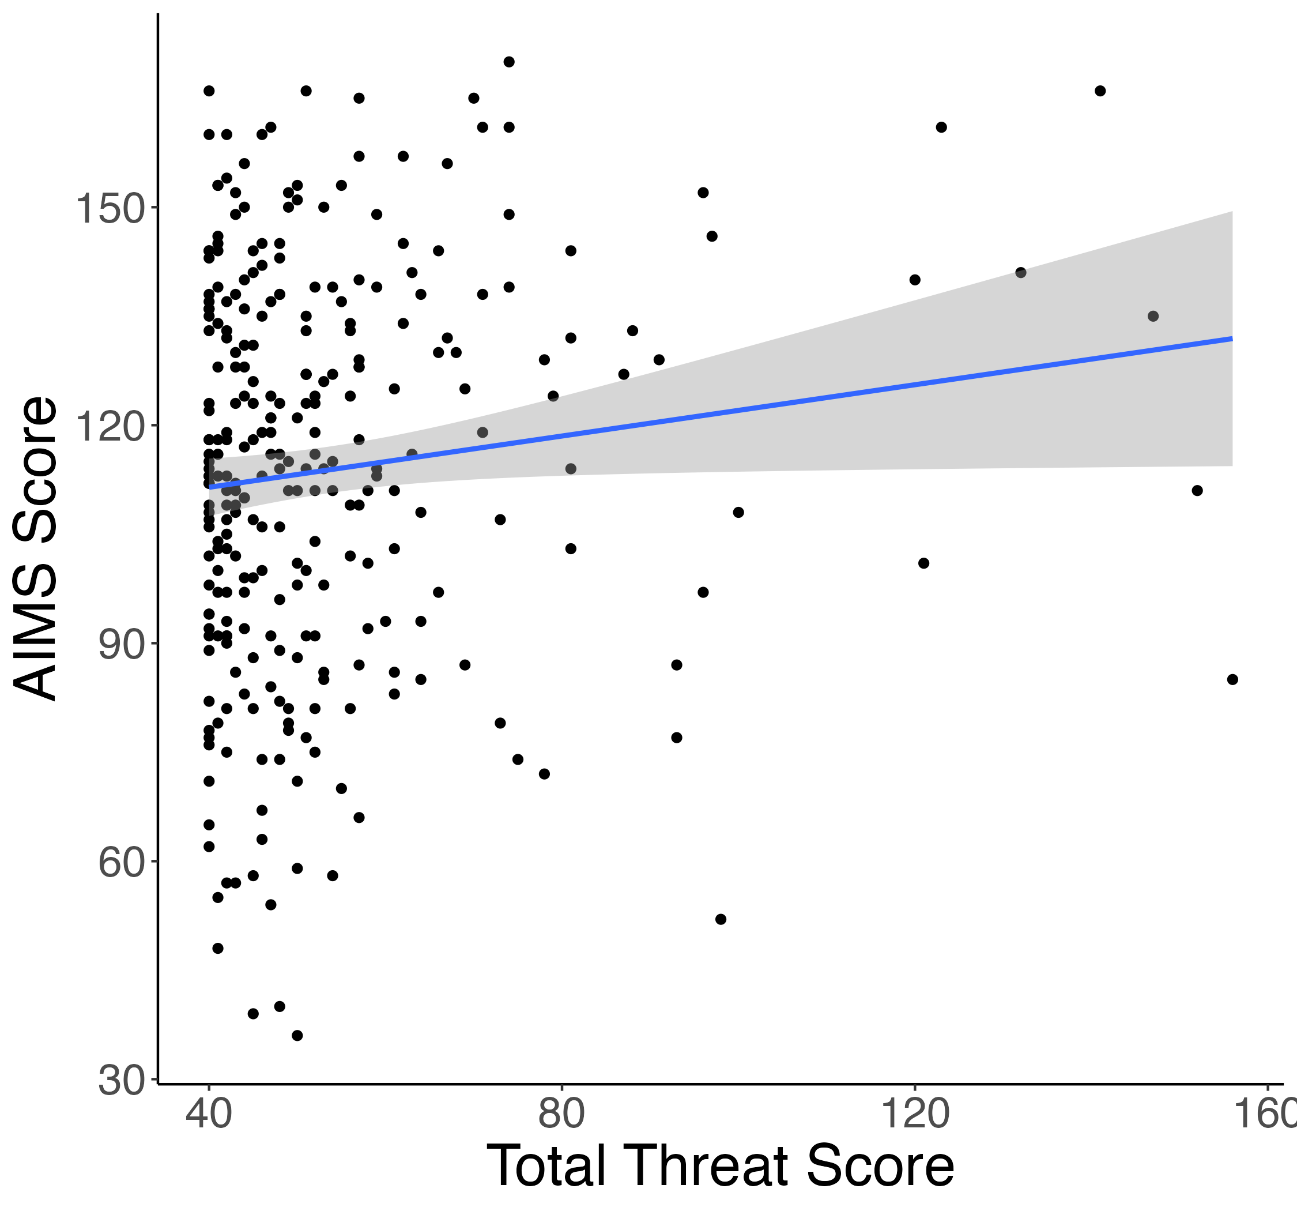
ELA & Absorption Correlations
Study 1
r = 0.15*
r = 0.17**
Study 2
r = 0.13*
r = 0.12*

Slide 5
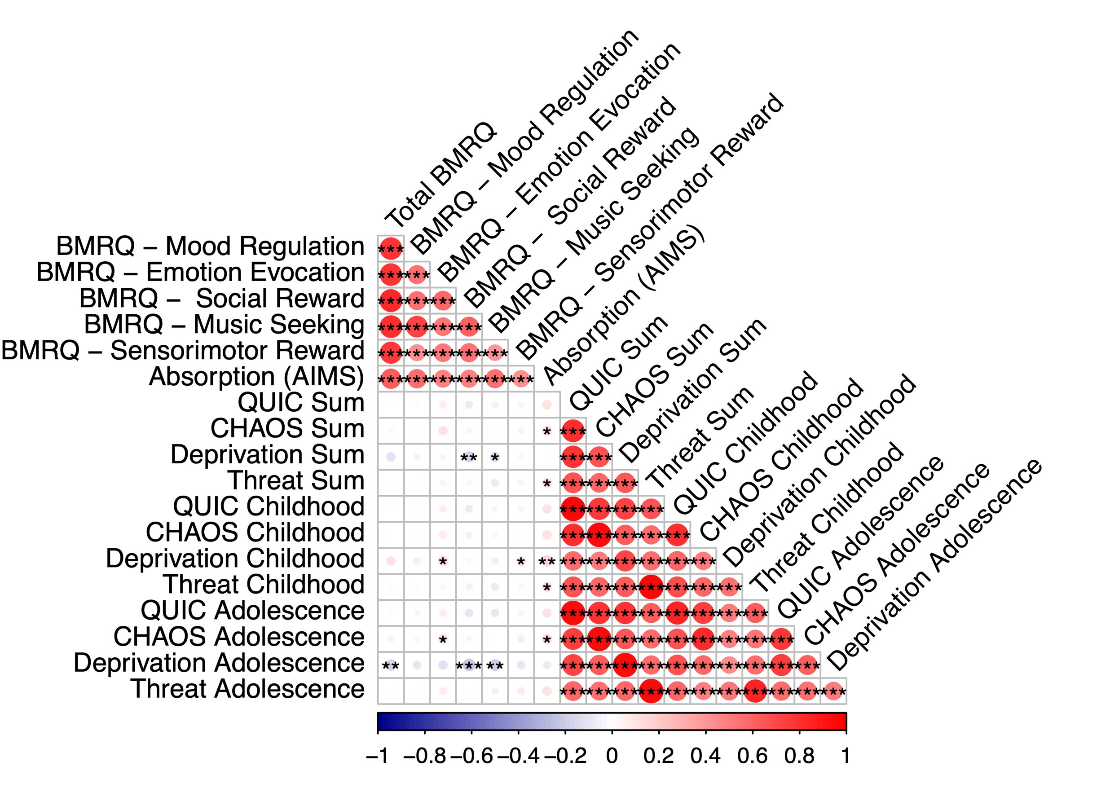
Correlation matrices for ELA + music measures
Study 1
Study 2

Slide 6
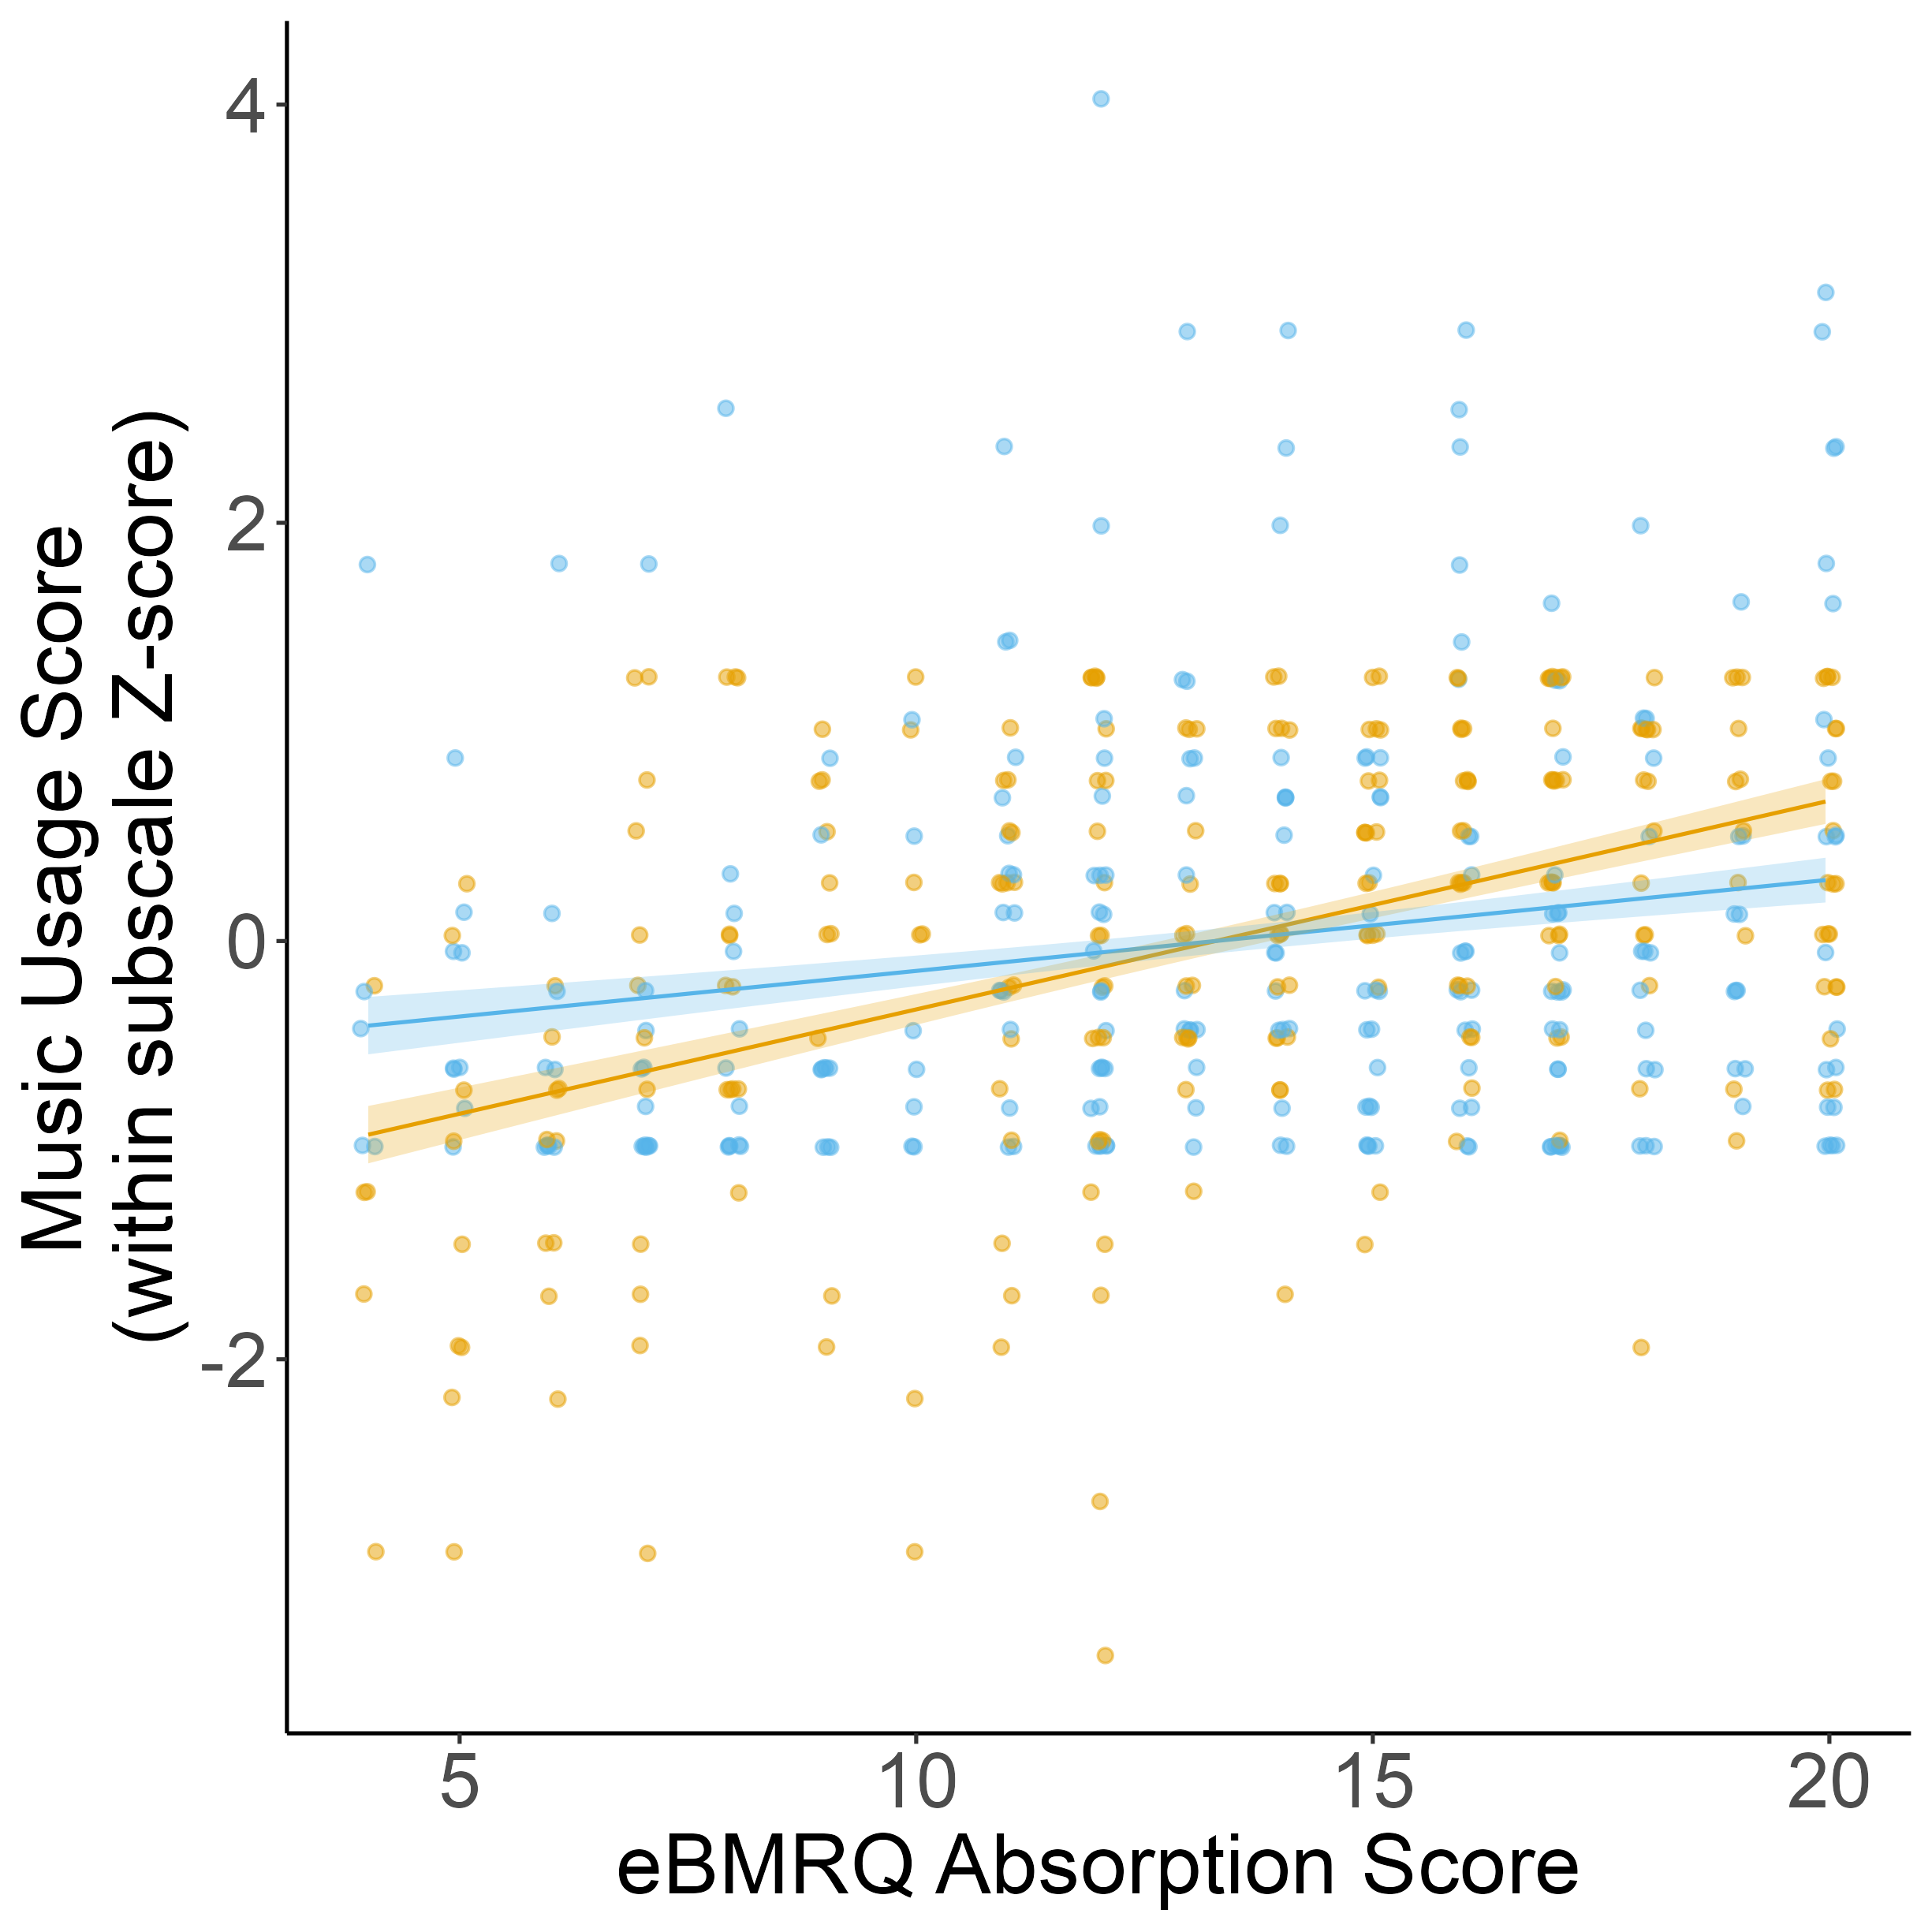
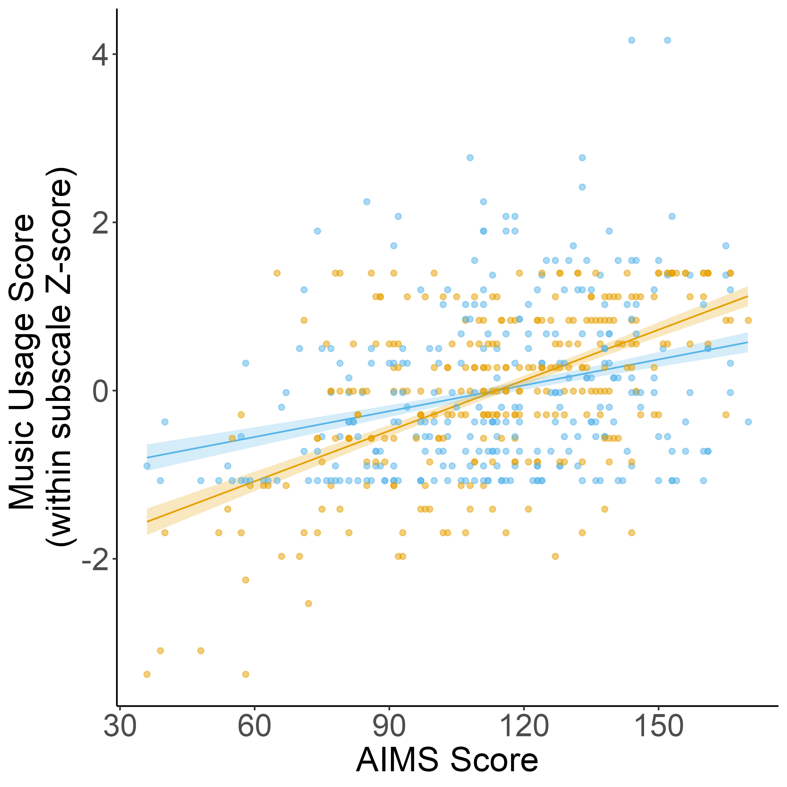
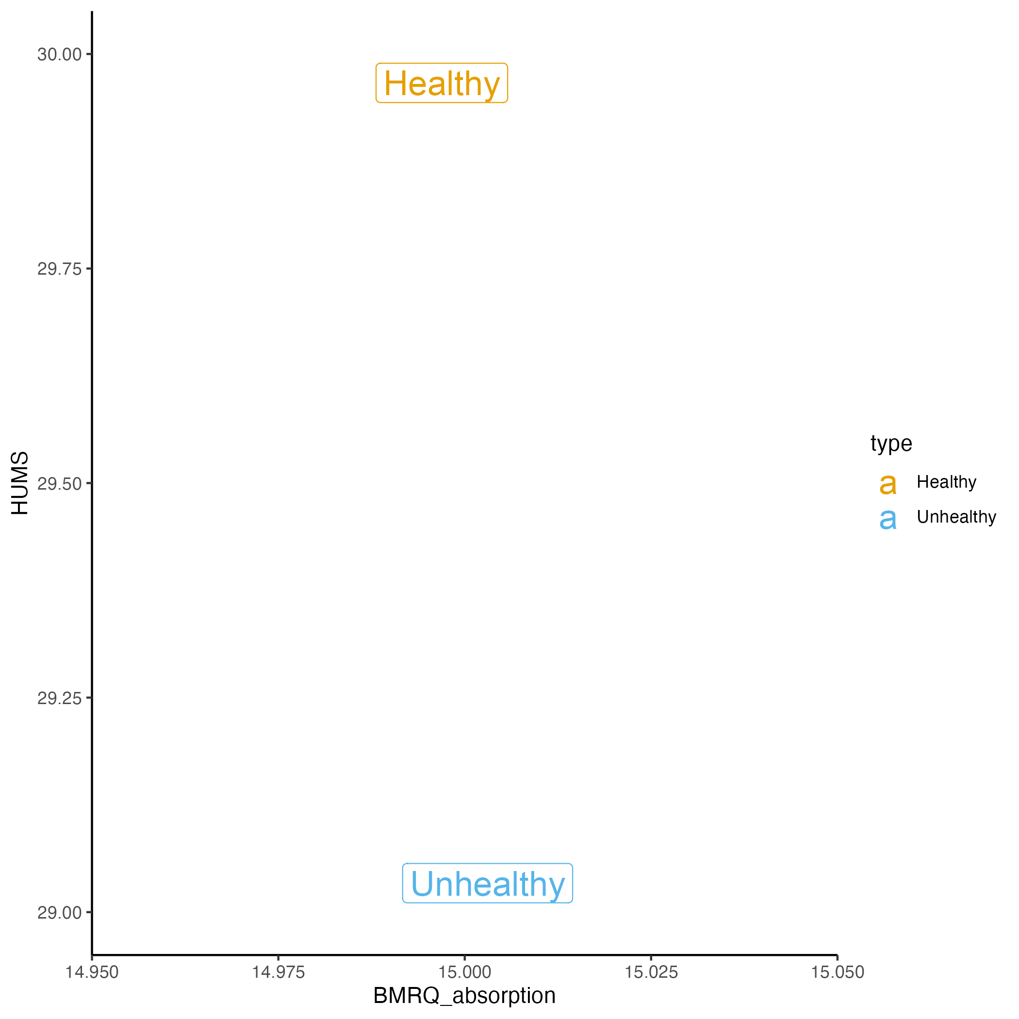
Absorption related to both healthy + unhealthy music usage, but more strongly associated with healthy music usage across both studies
Study 1
Study 2
Notes:
How do we account for the fact that there are more questions on Unhealthy compared to Healthy?

Slide 7
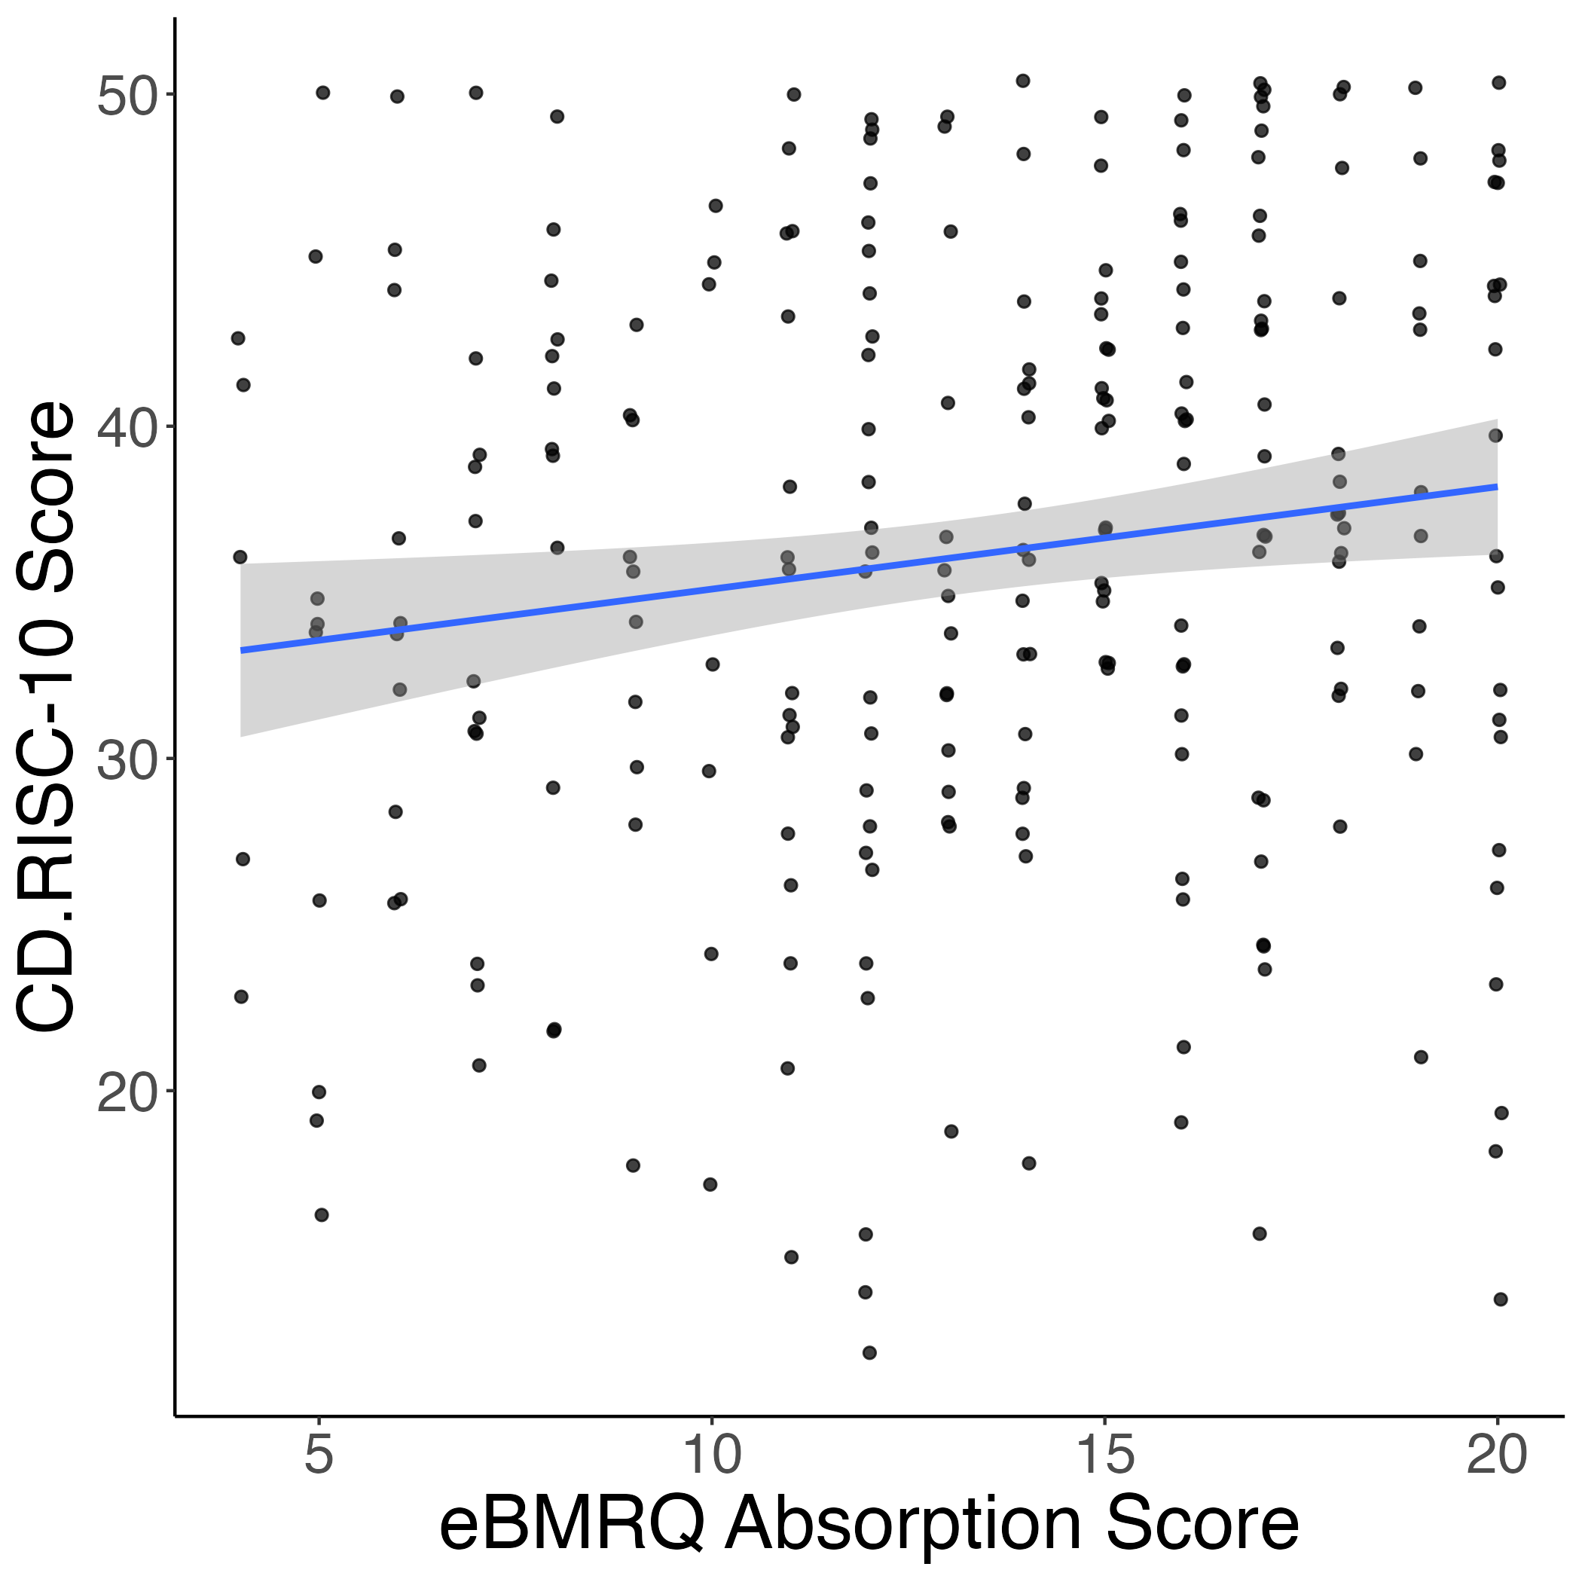
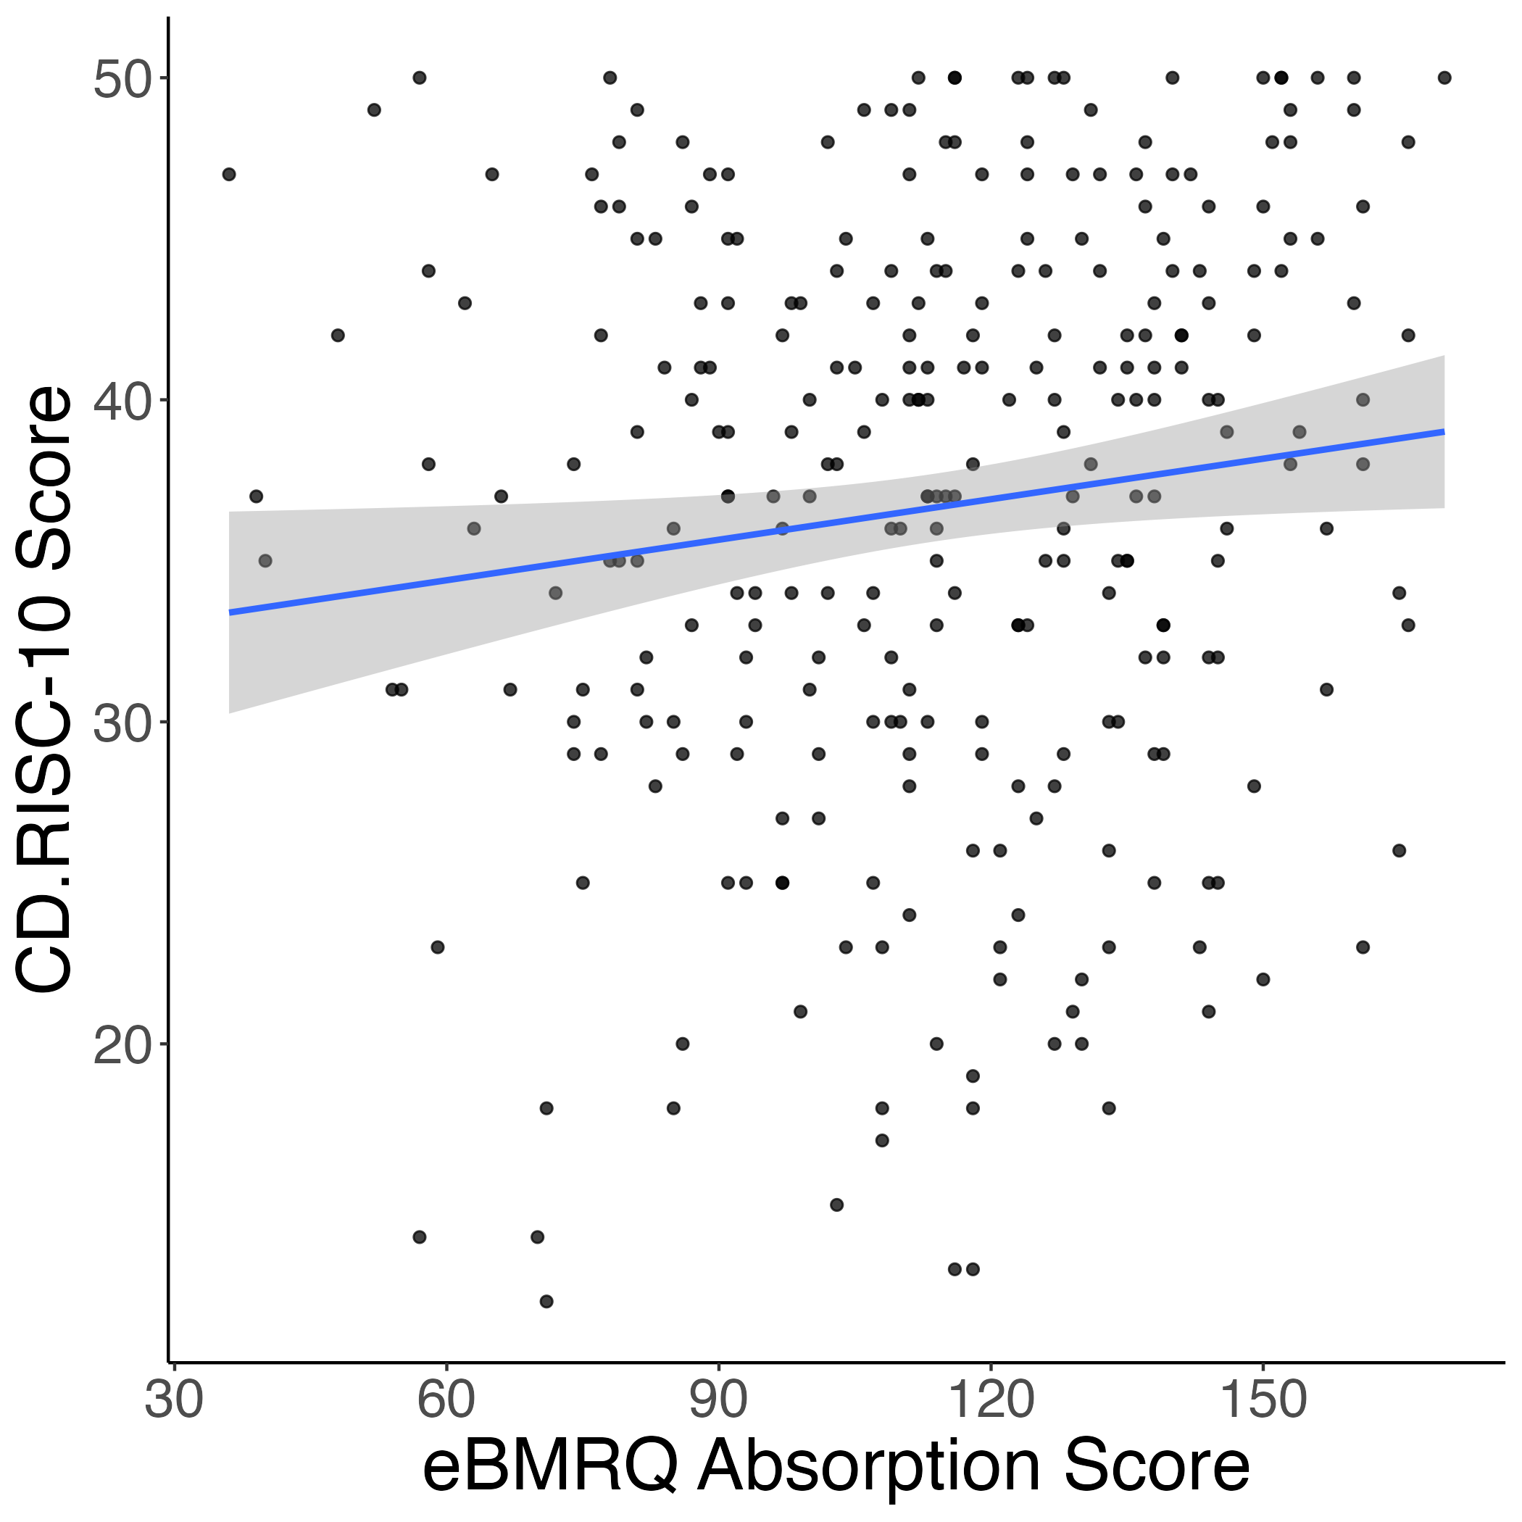
Absorption positively related to resilience
Study 1
Study 2
r = 0.15*
r = 0.13*

Slide 8
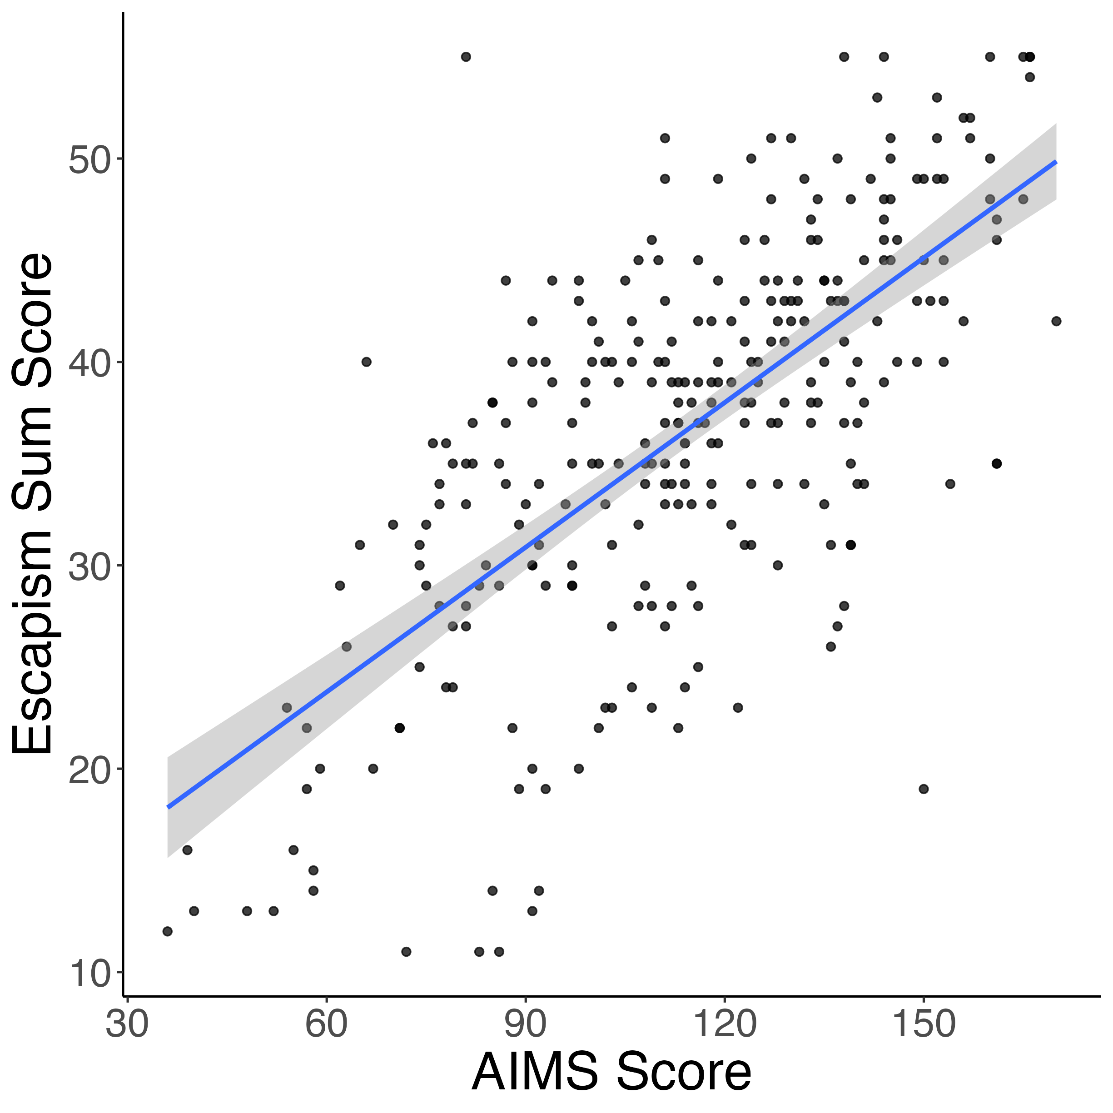
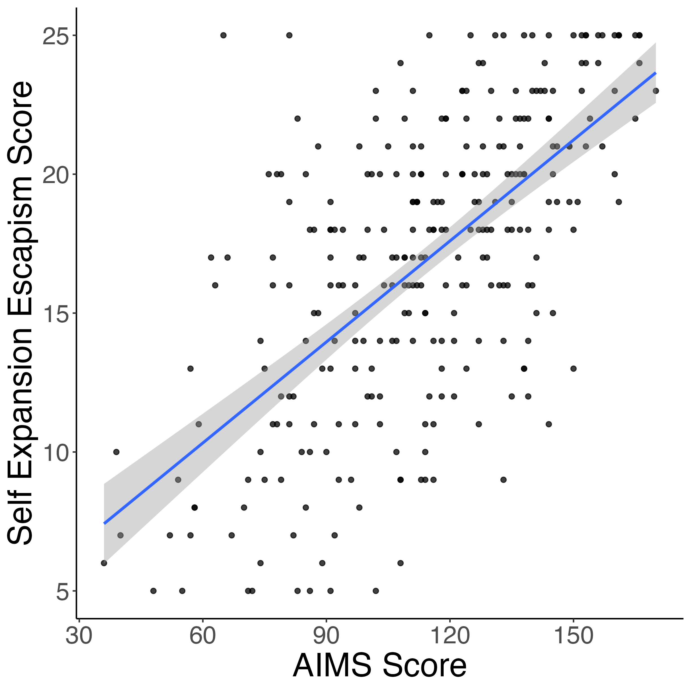
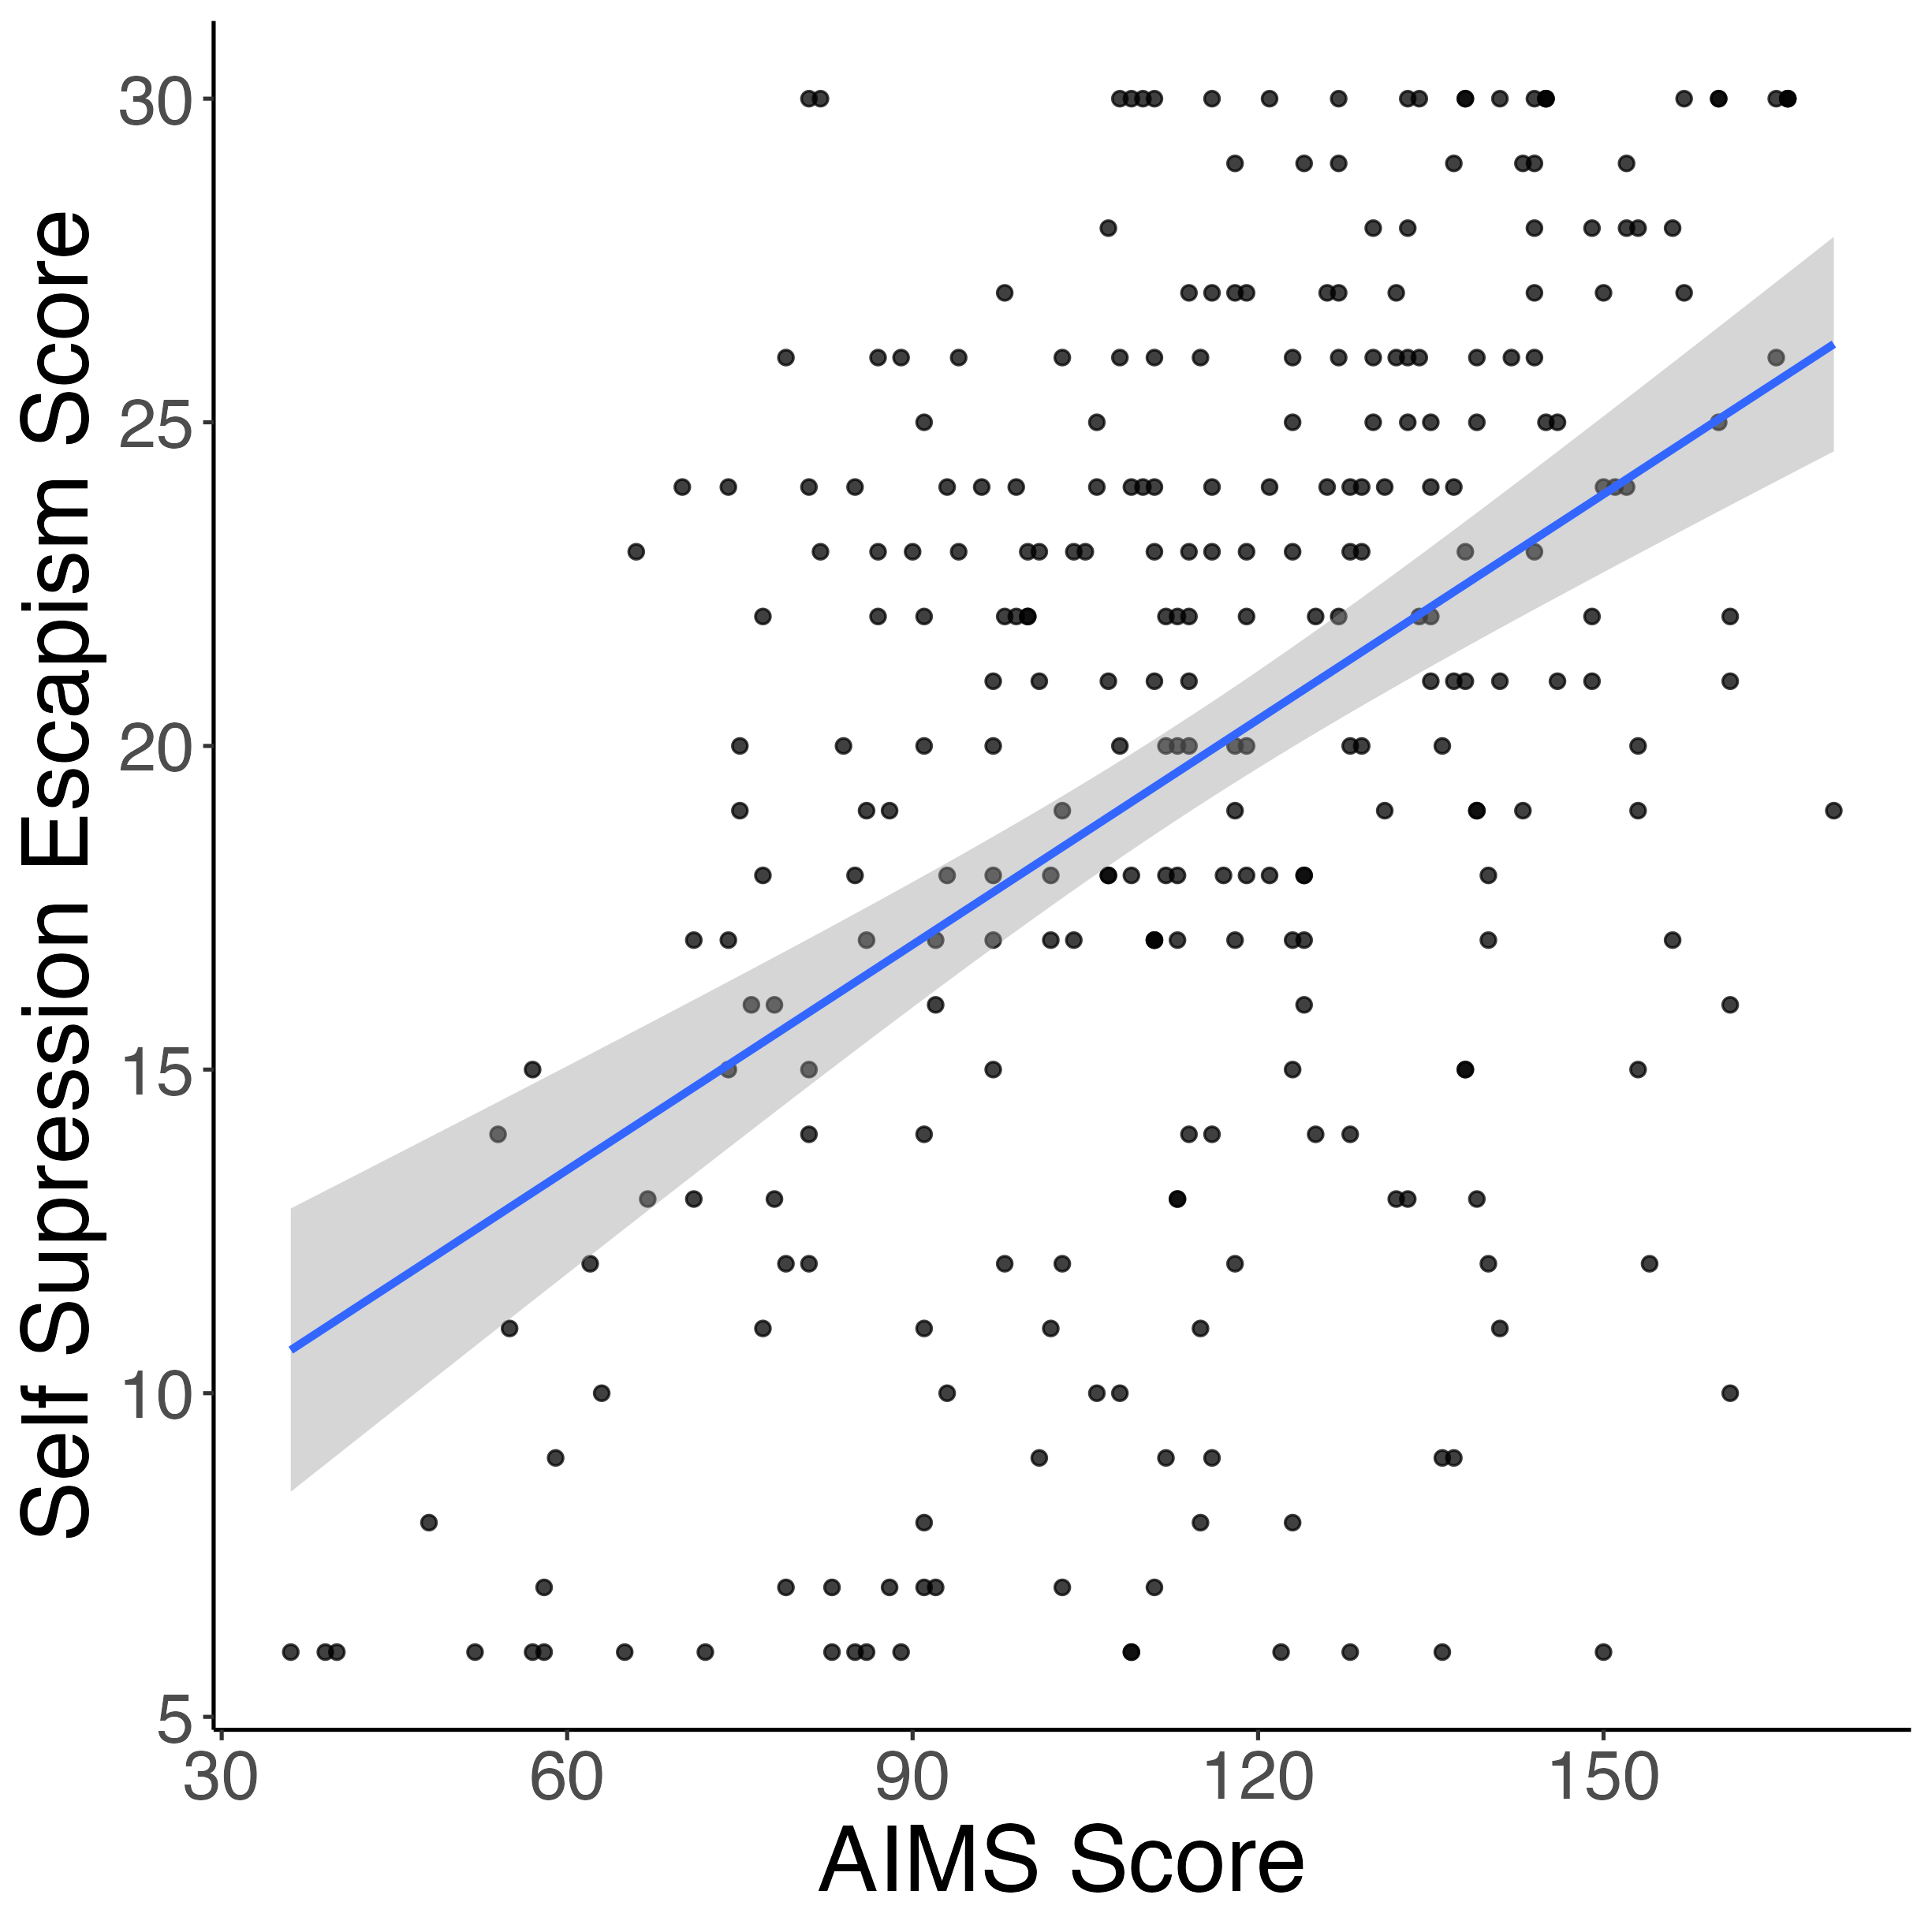
AIMS relates to music usage for escapism
r = 0.68***
r = 0.63***
r = 0.45***

Slide 9
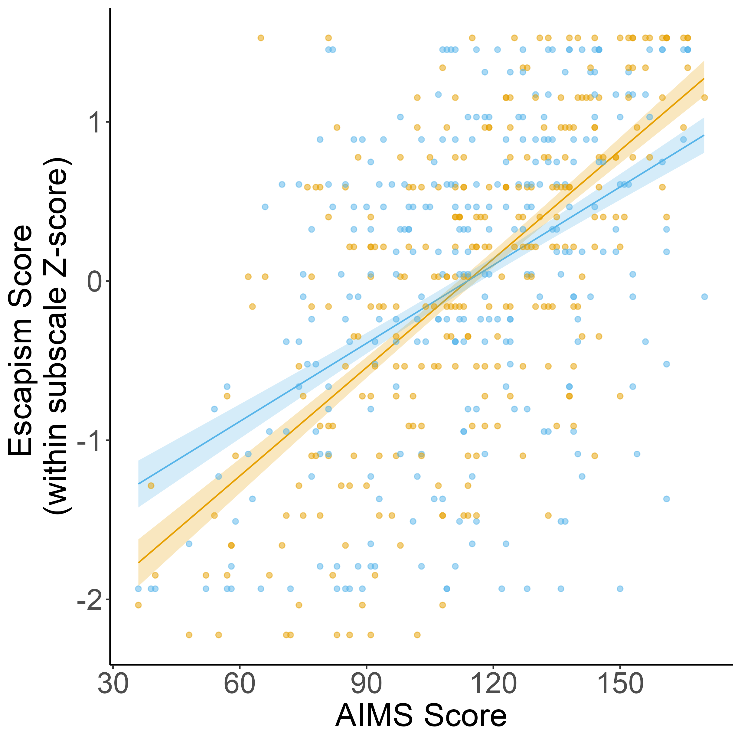
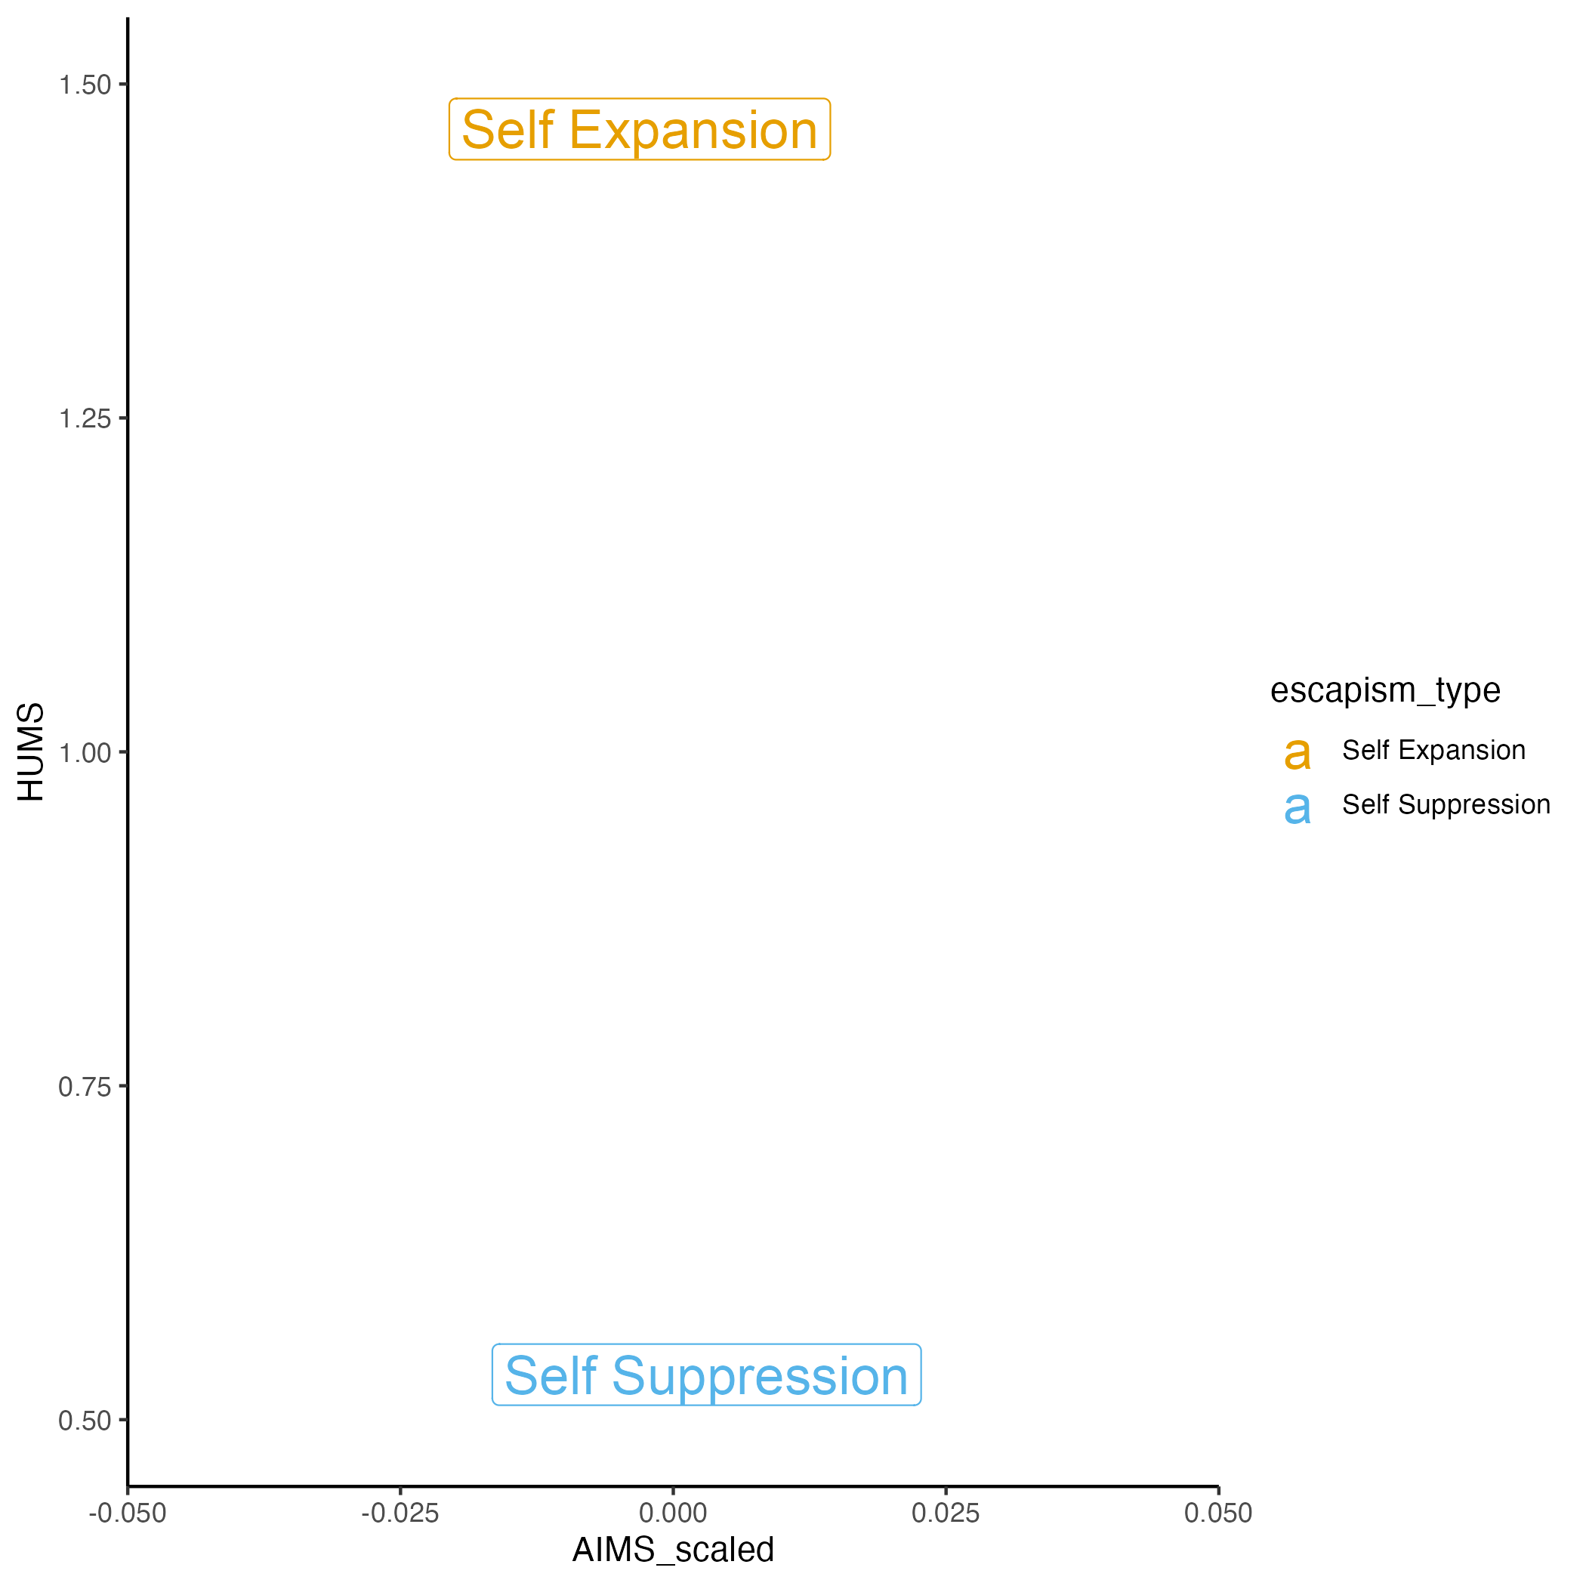
AIMS related more strongly to self expansion than self suppression

Slide 10
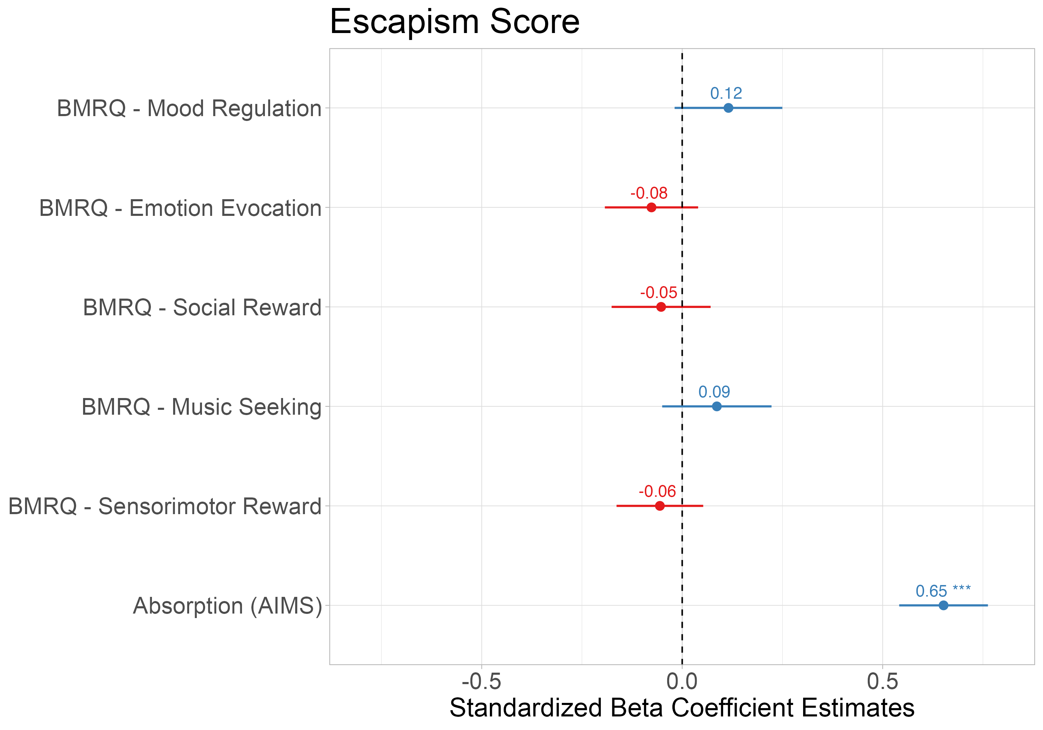
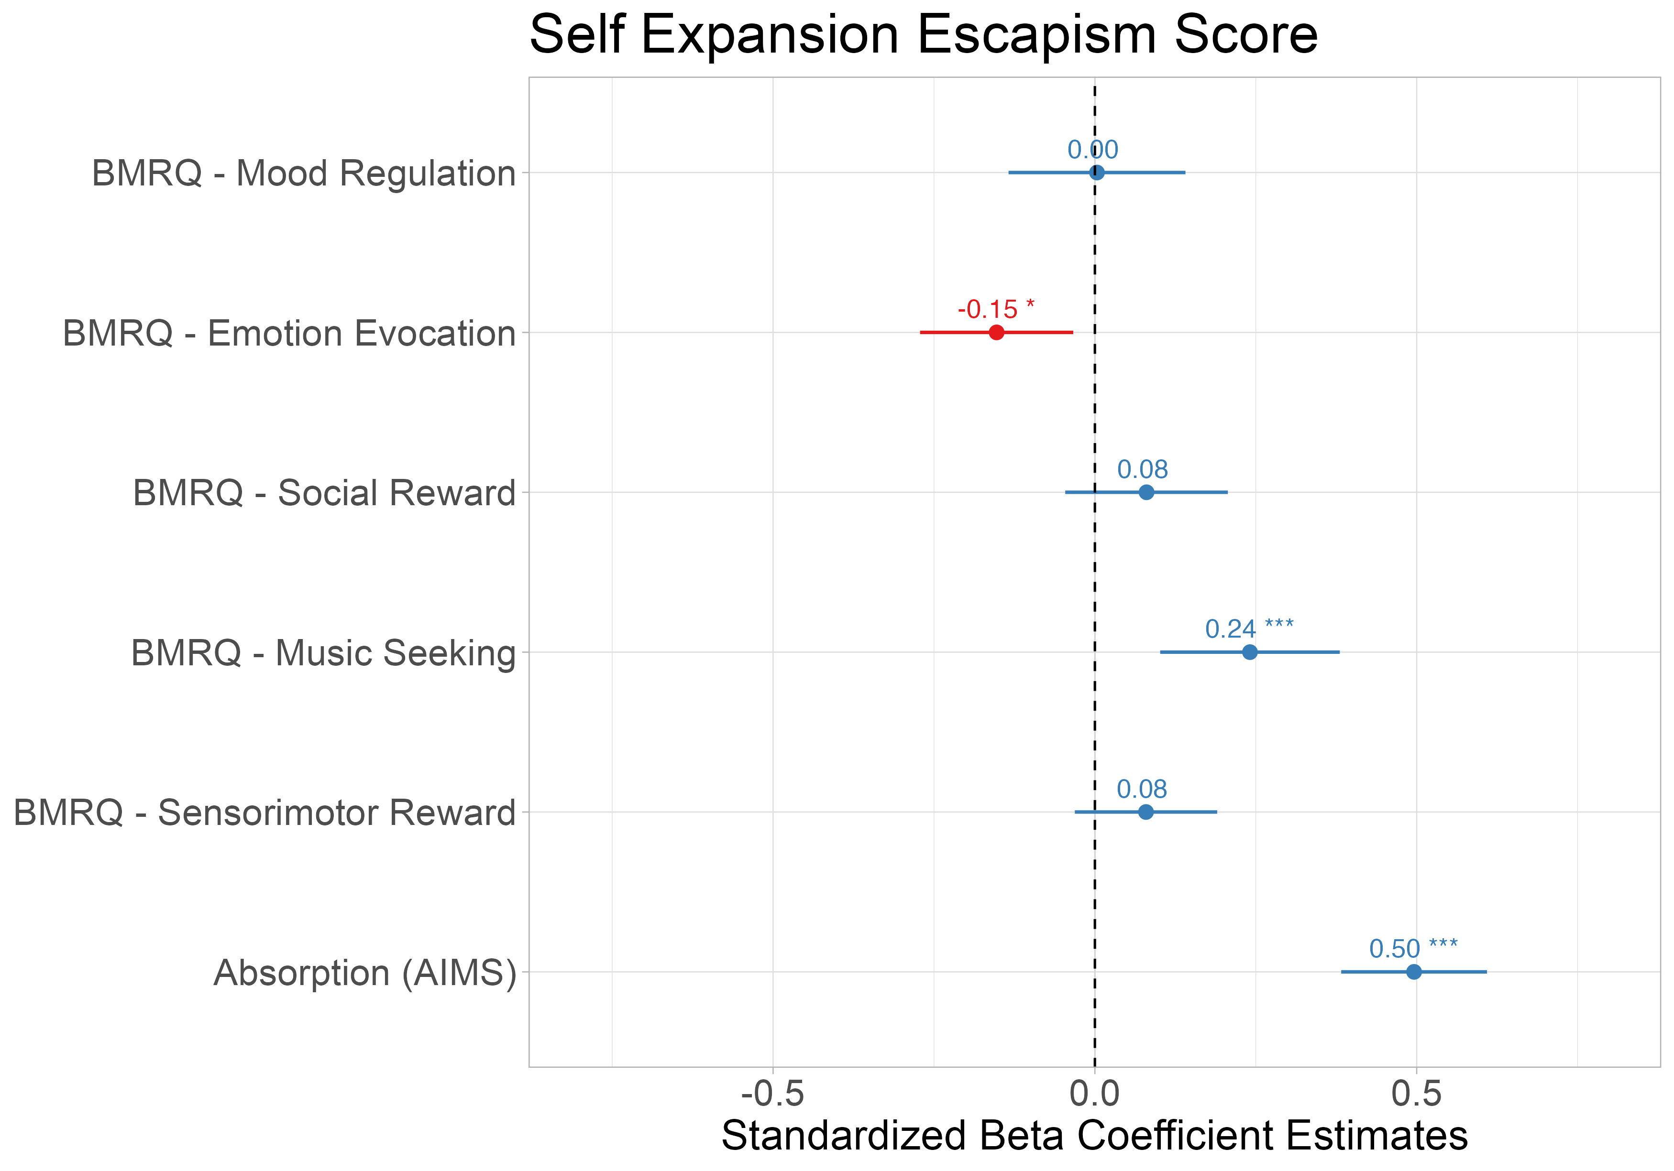
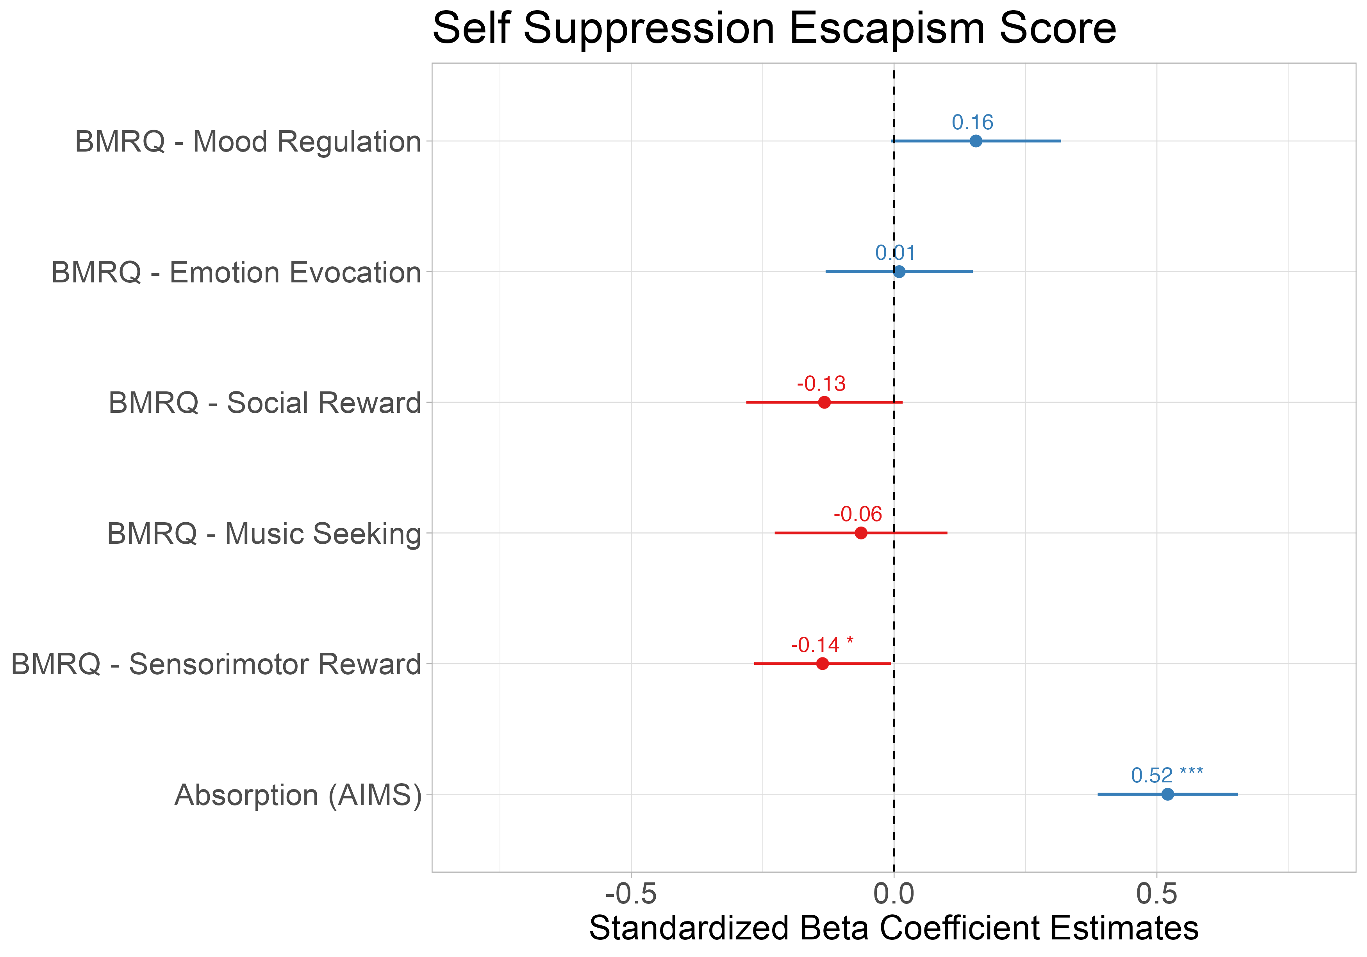
Absorption into music best explains music usage for escapism scores above and beyond other music reward sensitivity measures
Notes:
Secondary analyses of using subscales of escapism [pos & neg]; interaction with pos+neg but with just AIMS

Slide 11
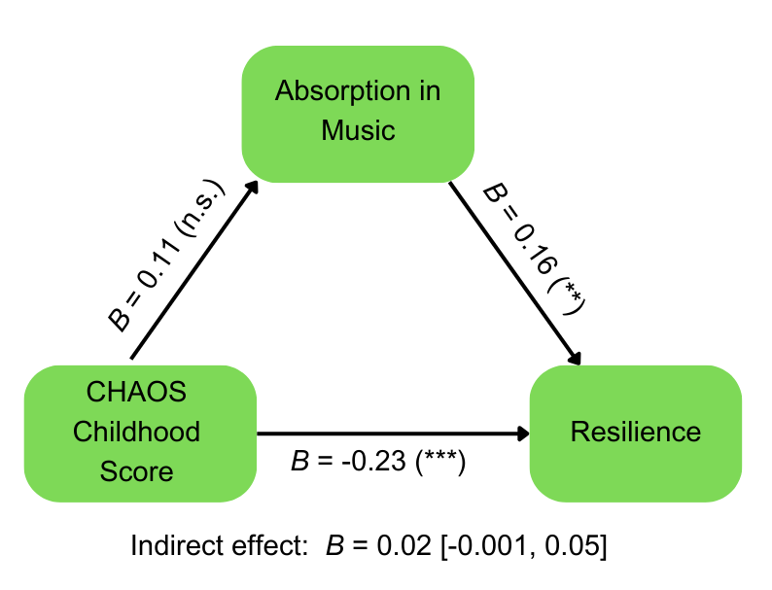
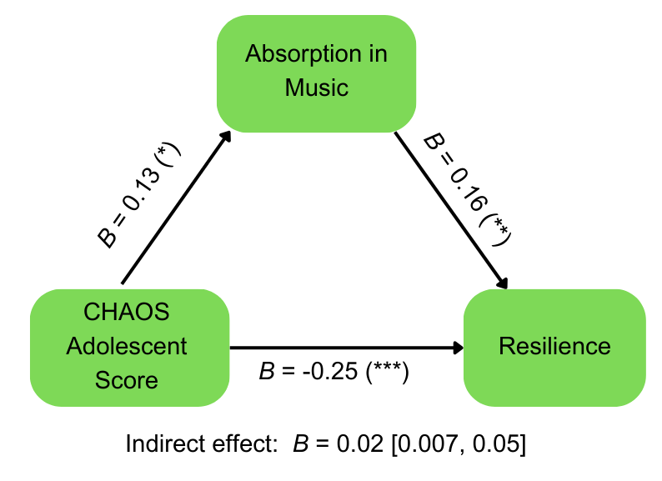
Absorption mediates the relationship between CHAOS and resilience
Notes:
Remains significant with age as covariate

Slide 12
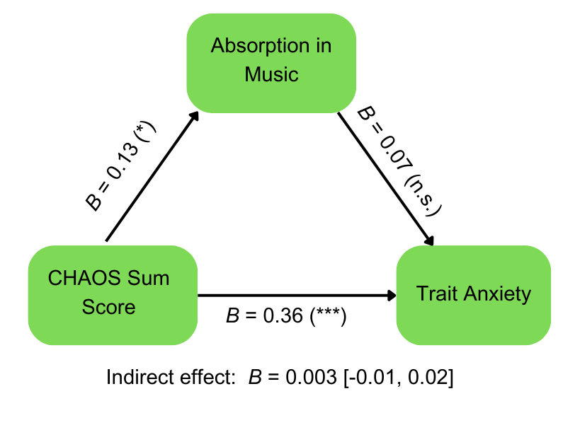
No mediation between CHAOS, AIMS, & STAI

